Slide 1

Ratio Analysis
Liquidity Ratios

Slide 2
Learning Outcomes
Appraise the liquidity position of the business entities.
Recommend how businesses could improve their liquidity position.

Slide 3
4 ‘Tools’ of Financial Statements Analysis
Comparative Financial Statements
Common – Size Financial Statements
Trend Analysis
Ratio Analysis

Slide 4
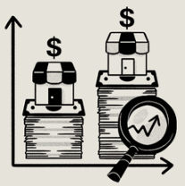
Ratio Analysis
A technique of evaluating the financial statements.
Helps to form opinions about businesses:-
Liquidity
Solvency
Profitability
Efficiency

Slide 5
Liquidity Ratios
Measures short – term solvency position
Components Involved
Checks business’s ability to meet current obligations
Current Assets
Current Liabilities

Slide 6
Measuring ‘working capital’ position
Current Assets
Cash balance
Inventory
Current Liabilities
Short term loans
Overdrafts
Bank balance
Investments (short term)
Receivables
Outstanding Expenses
P/P Expenses
Payables

Slide 7
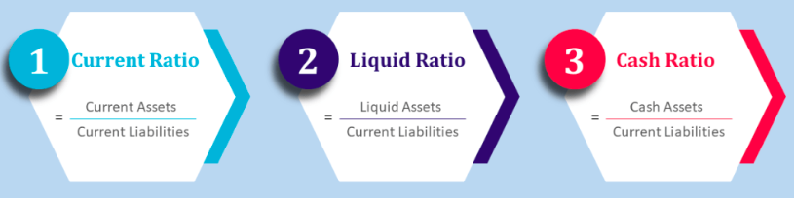
Types of Liquidity Ratios

Slide 8
1.) Current Ratio
Current Assets
Current Liabilities
Checks whether CA is enough to pay CL?
Checks whether ’safety margin’ available to creditors?
Ideal Current ratio?
(depends upon industry)
Between 1-3
Satisfactory
Less than 1
Unsatisfactory

Slide 9
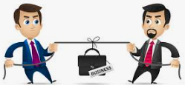
Case Analysis – Marico Vs. Colgate Palmolive
Appraise the current assets of both companies and review which of the two companies has the better liquidity position.
Particulars | Marico | Colgate Palmolive
Cash | 55,000 | 6,000
Inventory | 20,000 | 90,000
Receivables | 14,000 | 3,000
Current Liabilities | 44,500 | 49,500
Current Ratio | 2:1 | 2:1
Notes:
Colgate Palmolive is likely to have difficulties in paying its short-term obligations because most of its current assets consist of inventory. Inventory is not quickly convertible into cash. Marico is likely to pay its current obligations as they become due because a large portion of its current assets consists of cash and accounts receivables. Receivables are highly liquid and can be converted into cash quickly.
From this analysis, it is clear that the analyst should not only see the current ratio but also the composition of current assets.

Slide 10
Activity
Following are the current assets & current liabilities for Ceat Ltd. (a tyre manufacturing company) for the past 3 years (In Rs. Crores).
Analyse which of the statements are true with regard to its current ratio.
Less safety margin is available to the creditors of Ceat Ltd.
Ceat Ltd. can easily pay off its short-term debts
Ceat Ltd. is having sufficient current assets with regard to current liabilities in past three years
The liquidity position of Ceat Ltd. is satisfactory
Component | March 2022 | March 2021 | March 2020
Current Assets | 2,580 | 2,200 | 1,762
Current Liabilities | 3,826 | 3,325 | 2,265

Slide 11
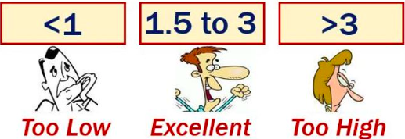
Appraising Current Ratio
Poor financial health
Improper use of CA
CL can be paid off easily

Slide 12
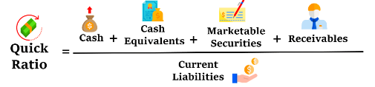
2.) Quick Ratio (Acid – Test Ratio/Liquid Ratio)
Strict test of liquidity
Ideal quick ratio (Greater/Near to 1)
Excludes ‘inventory’ & ‘prepaid expenses’

Slide 13
Case Analysis – Quick Ratio in Paint Industry
Following are the quick ratios for the three prominent companies in the paint industry for the year ending March 2022.
Analyse the liquidity position of this industry with respect to the quick ratio.
Company | Asian Paints | Berger Paints | Indigo Paints
Quick Ratio | 1.20 | 0.5 | 1.96

Slide 14
3.) Cash Ratio
Adopts a conservative approach
Cash + Short term Investments
Current Liabilities
Preferable Cash Ratio = 0.5:1

Slide 15
Poll
A manufacturing business is interested in determining the measure of it’s liquidity.
The ______ is a measure of liquidity that excludes generally the least liquid asset.
Liquid ratio, Accounts receivable.
Current ratio, inventory.
Liquid ratio, inventory.
Current ratio, Accounts receivable.

Slide 16
Self – Practice Problem
Following is the list of assets and liabilities of a manufacturing business. Calculate the short term solvency position using three liquidity ratios and interpret the results.
Particulars | Amount (in Rs.)
Plant and Machinery | 400,000
Receivables | 40,000
Marketable securities | 150,000
Cash & bank balance | 75,000
Inventories | 35,000
Bank overdraft | 70,000
Payables | 60,000
Outstanding expenses | 30,000
Creditors | 90,000

